Slide 1




The course notes are partly based on the Machine learning course presented by Andrew Ng at Stanford University and the original can be found at https://www.coursera.org/course/ml b
e.
All materials without annotations or marks are copyrighted by their copyright owner.
All the codes and modified slides are available at Github
The project homepage:
https://github.com/sunzuolei/ml
The Git repository:
https://github.com/sunzuolei/ml.git

Slide 2
Supervised learning
Regression
Classification
Continuous output
Discrete output
Unsupervised learning

Slide 3
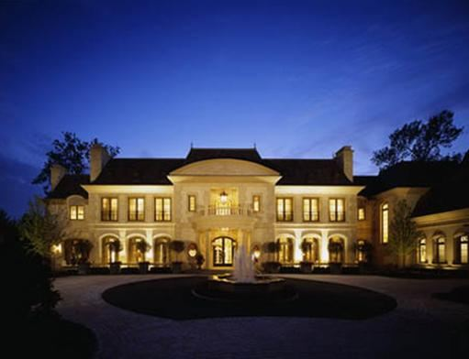

Slide 4










Slide 5
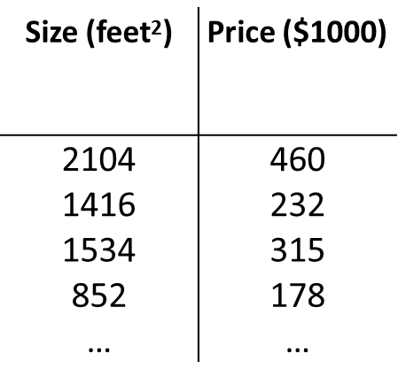



Slide 6

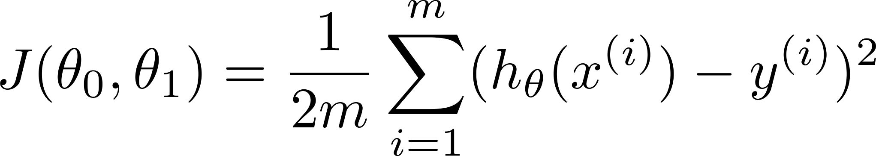
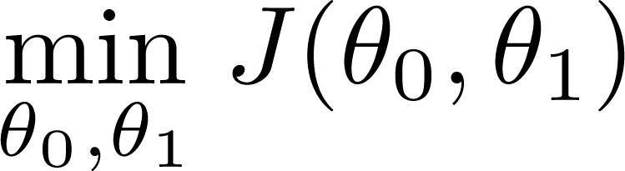

Slide 7
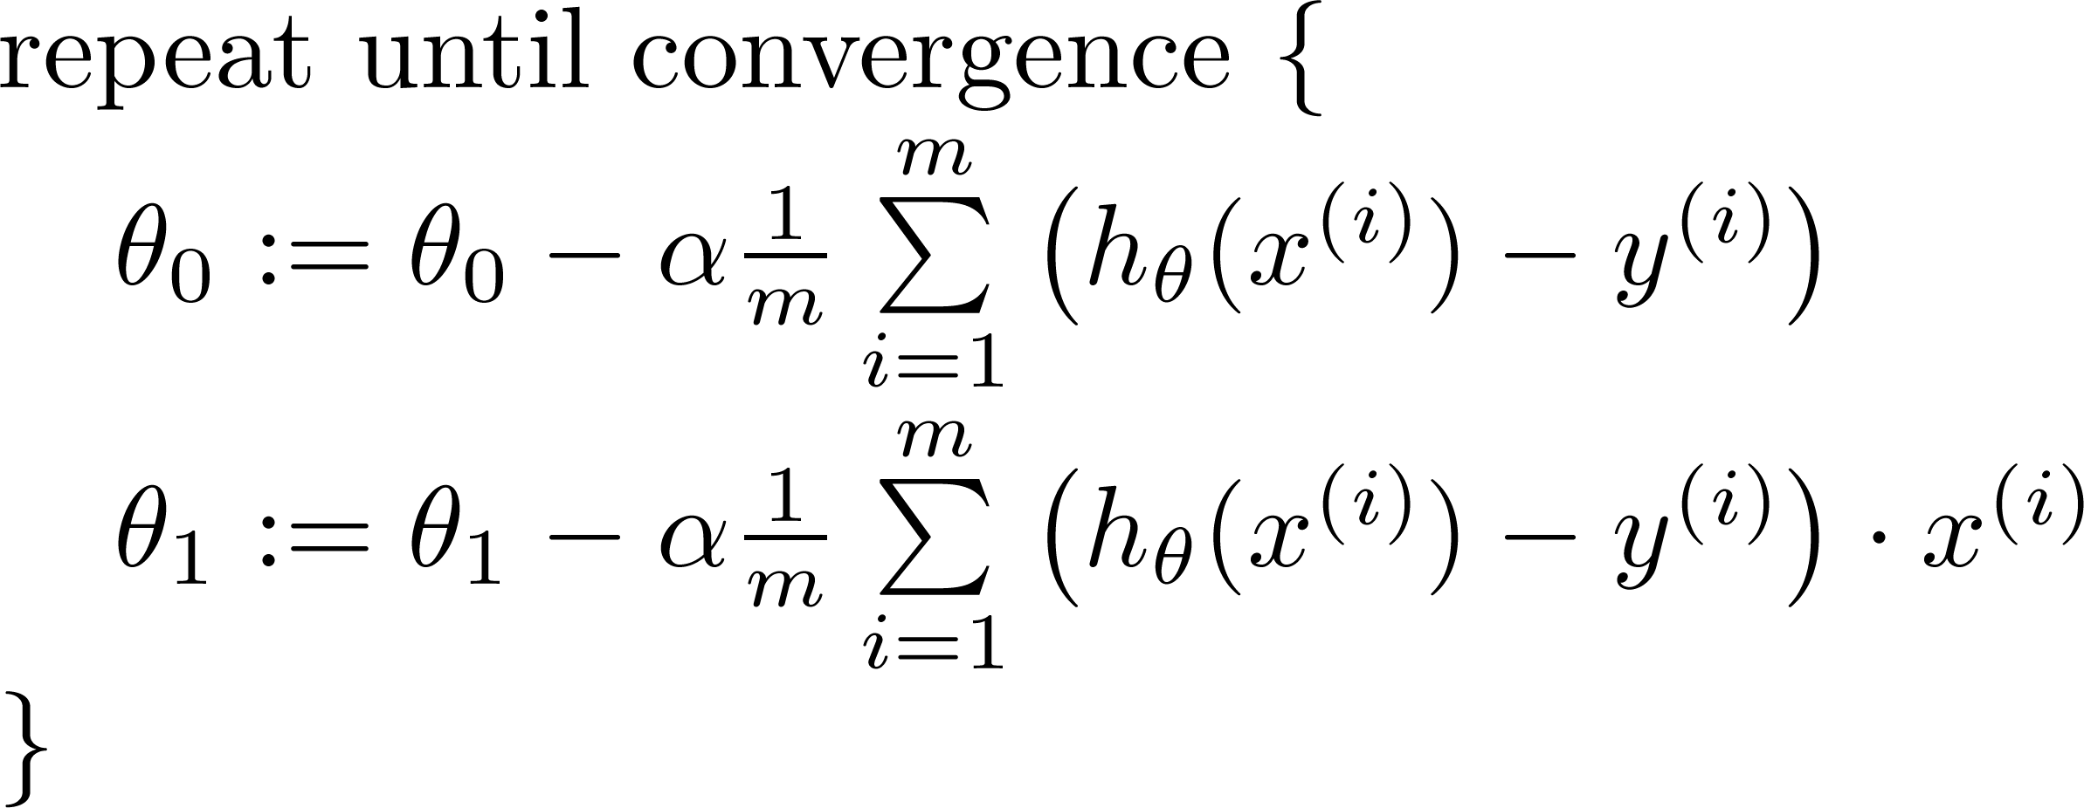

Slide 8
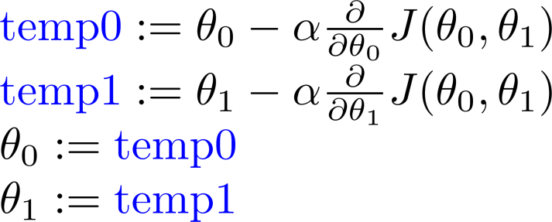
P3

Slide 9

Does the house price only depend on size?
NO

Slide 10

Multiple features
Linear Regression with multiple variables
Machine Learning

Slide 11



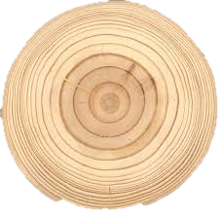
Multiple features (variables).
Size (feet²) | Number of bedrooms | Number of floors | Age of home (years) | Price ($1000)
2104 | 5 | 1 | 45 | 460
1416 | 3 | 2 | 40 | 232
1534 | 3 | 2 | 30 | 315
852 | 2 | 1 | 36 | 178
… | … | … | … | …

Slide 12
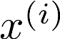
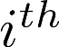
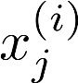
Multiple features (variables).
Size (feet²) | Number of bedrooms | Number of floors | Age of home (years) | Price ($1000)
2104 | 5 | 1 | 45 | 460
1416 | 3 | 2 | 40 | 232
1534 | 3 | 2 | 30 | 315
852 | 2 | 1 | 36 | 178
… | … | … | … | …
Notation:
= number of features
= input (features) of training example.
= value of feature in training example.
Notes:
Pop-up Quiz

Slide 13
Hypothesis:
Previously:

Slide 14
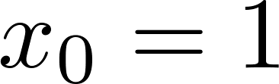
For convenience of notation, define .
Multivariate linear regression.

Slide 15
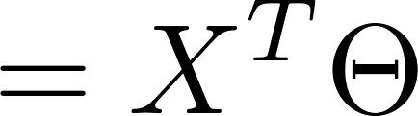
P4
For convenience of notation, define .
Let’s prove this by programming!

Slide 16
Gradient descent for multiple variables
Linear Regression with multiple variables
Machine Learning

Slide 17
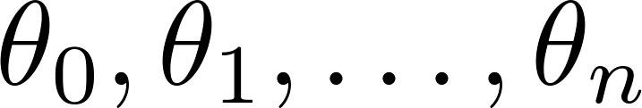
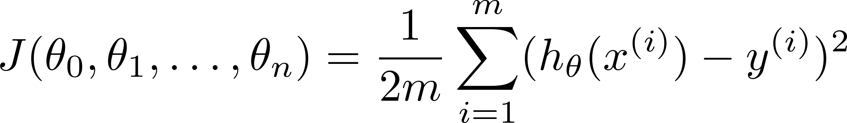

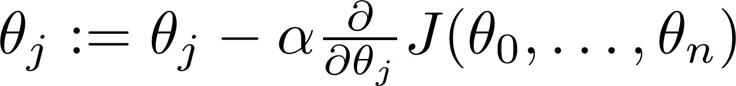

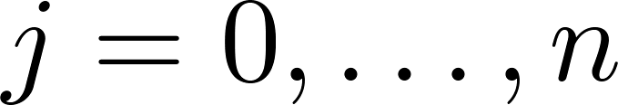
Hypothesis:
Parameters:
Cost function:
Gradient descent:
Repeat
(simultaneously update for every )

Slide 18
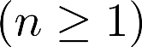
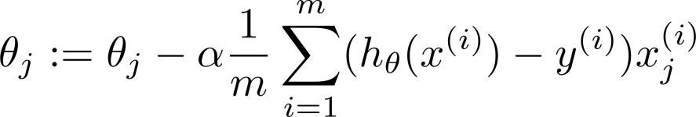
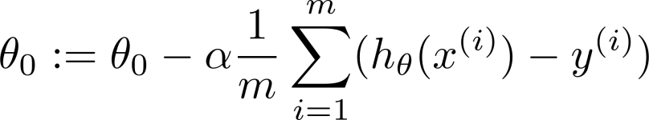
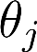
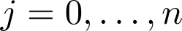
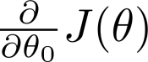
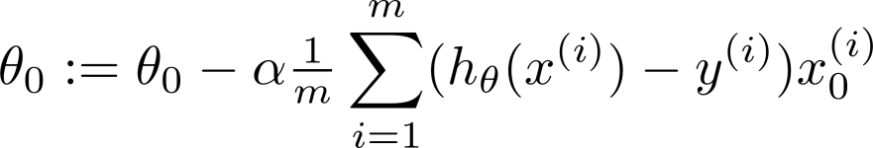
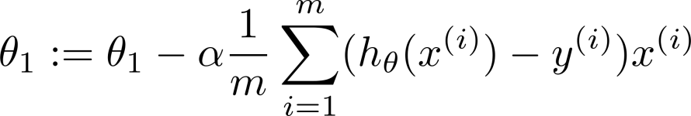
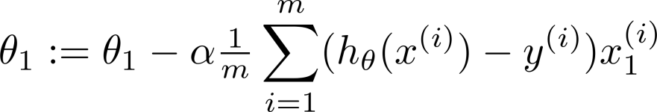
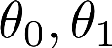
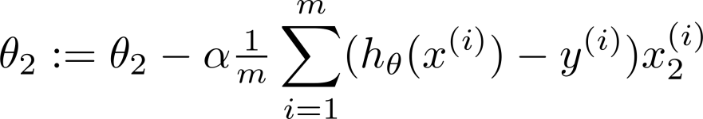
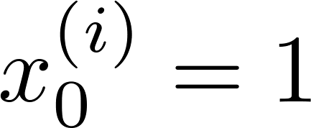
New algorithm :
Gradient Descent
Repeat
Previously (n=1):
Repeat
(simultaneously update for
)
(simultaneously update )

Slide 19
Gradient descent in practice I: Feature Scaling
Linear Regression with multiple variables
Machine Learning

Slide 20
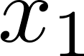
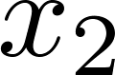

Feature Scaling
Idea: Make sure features are on a similar scale.
E.g. = size (0-2000 feet²)
= number of bedrooms (1-5)

Slide 21
Feature Scaling
Idea: Make sure features are on a similar scale.
P5
E.g. = size (0-2000 feet²)
= number of bedrooms (1-5)
Let’s implement the PARTAL cost function ignoring theta0!

Slide 22


for theta1 = theta1Seq
c = 1;
for theta2 = theta2Seq
Theta = [theta1; theta2];
h = X * Theta;
costSeq(r, c) ...
= sum((h - y).^2 ) / (2 * m);
c = c + 1;
end
r = r + 1;
end
Ugly
Expensive
P6
Let’s implement the vectorization!

Slide 23
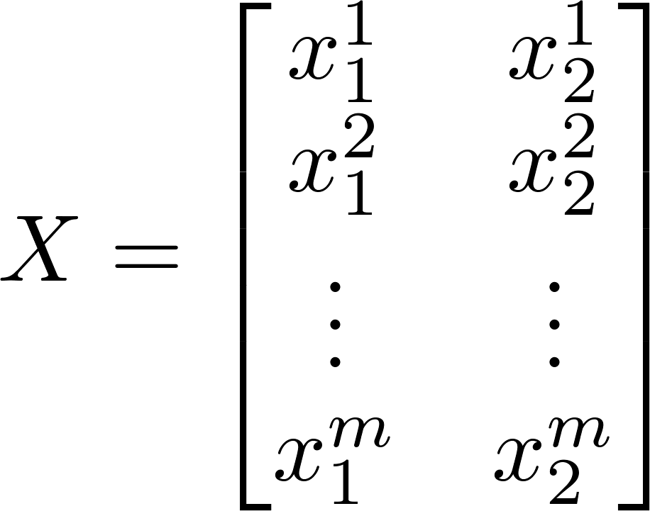
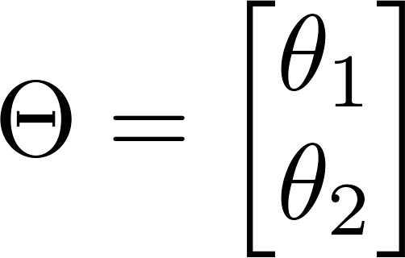
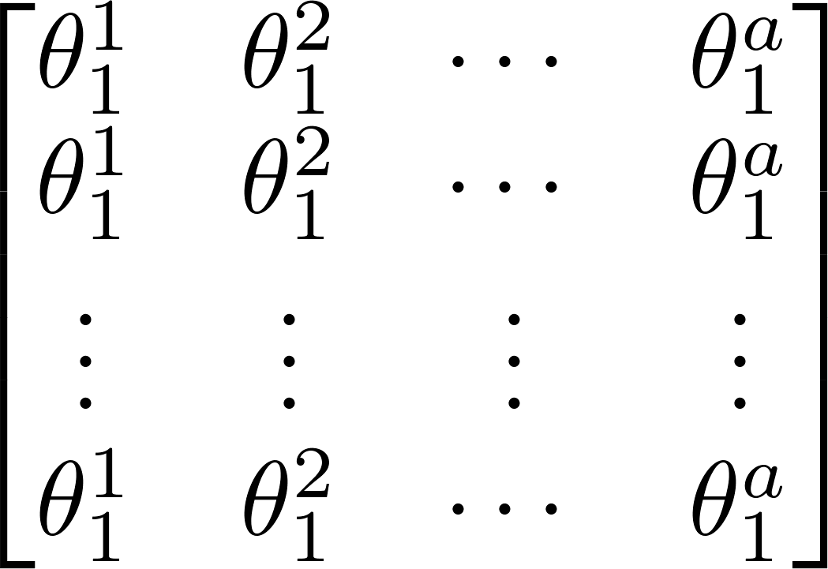



1*a
1*b
b*a
theta1SeqTem = repmat (theta1Seq, [b, 1])
theta1SeqTem = reshape(theta1SeqTem,1,[])
1*a*b
1*b
1*b
theta2SeqTem = repmat (theta2Seq, [1, a]);
1*a*b
1*b
1*b

Slide 24
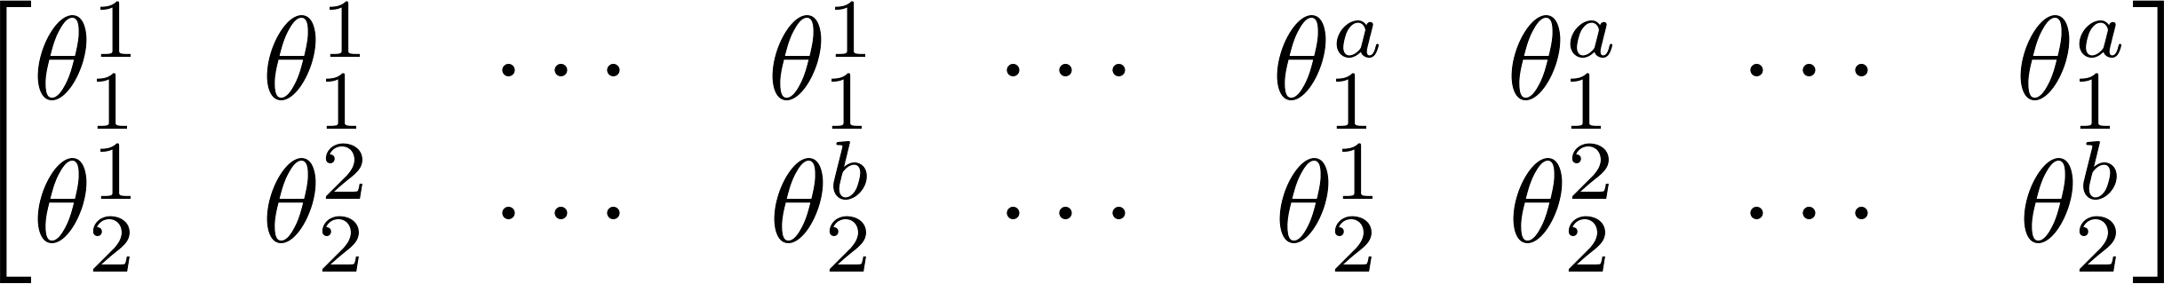
ThetaSeq = [theta1SeqTem; theta2SeqTem];
2*a*b
1*a*b
1*b
1*b
theta2SeqTem = repmat (theta2Seq, [1, a]);
1*a*b
1*b
1*b

Slide 25
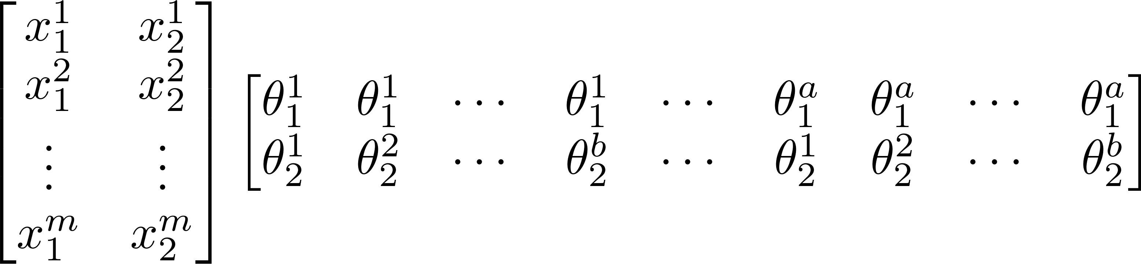
ThetaSeq = [theta1SeqTem; theta2SeqTem];
2*a*b
hSeq = X * ThetaSeq;
m*a*b
2*a*b
m*2
m*a*b
ySeq = repmat (y, [1, a*b]);
1*a*b
costSeqTem = sum((hSeq - ySeq).^2) / (2 * m);

Slide 26
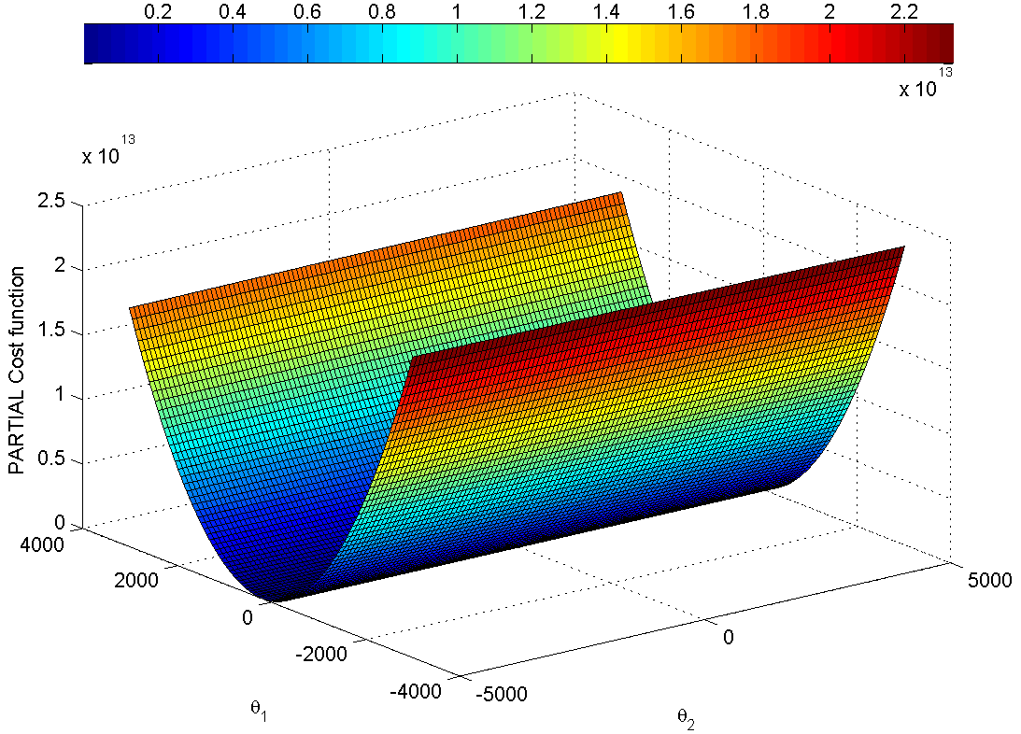
b*a
costSeqVec = reshape(costSeqTem, [b, a])
a*b
costSeqVec = reshape(costSeqTem, [b, a])’
a
b
1*a*b
costSeqTem = sum((hSeq - ySeq).^2) / (2 * m);

Slide 27
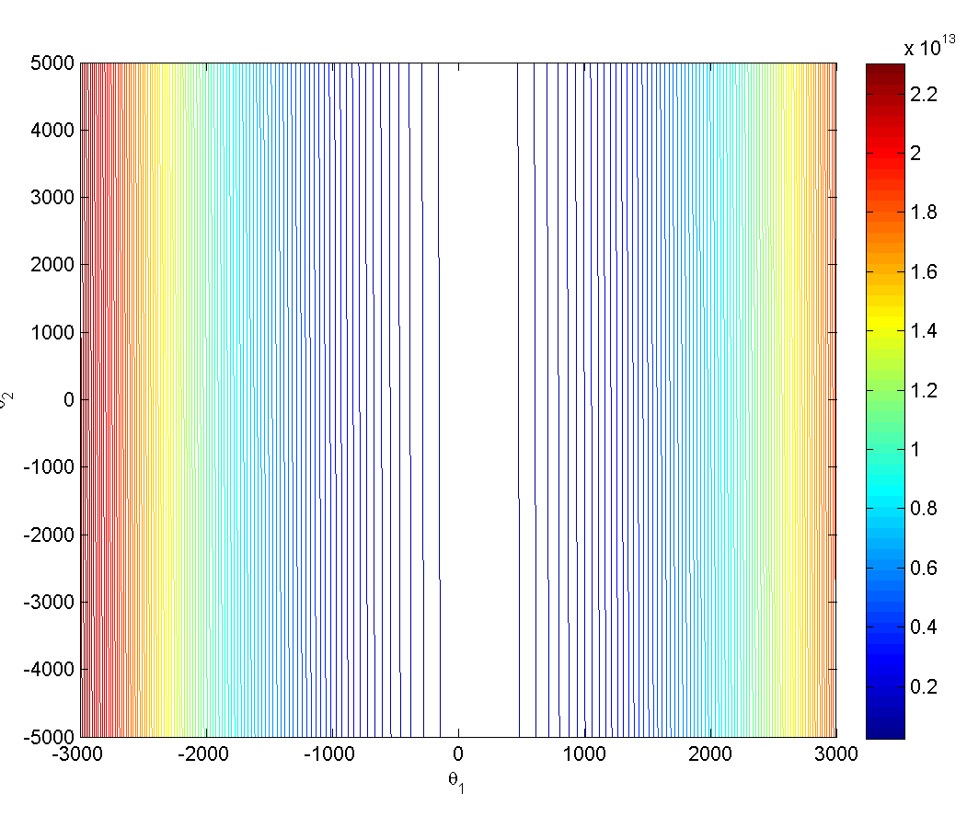
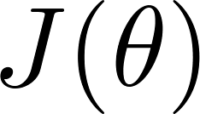
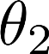
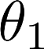
Feature Scaling
Idea: Make sure features are on a similar scale.
E.g. = size (0-2000 feet²)
= number of bedrooms (1-5)

Slide 28
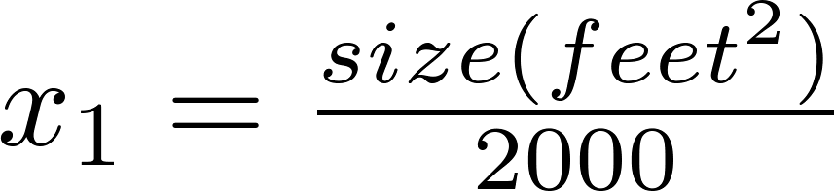
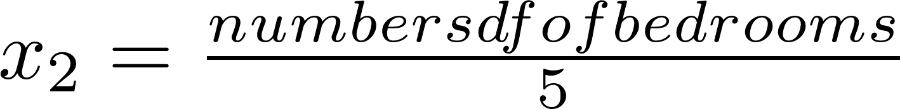
Feature Scaling
Idea: Make sure features are on a similar scale.
E.g. = size (0-2000 feet²)
= number of bedrooms (1-5)
size (feet²)
number of bedrooms

Slide 29
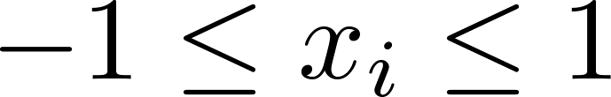
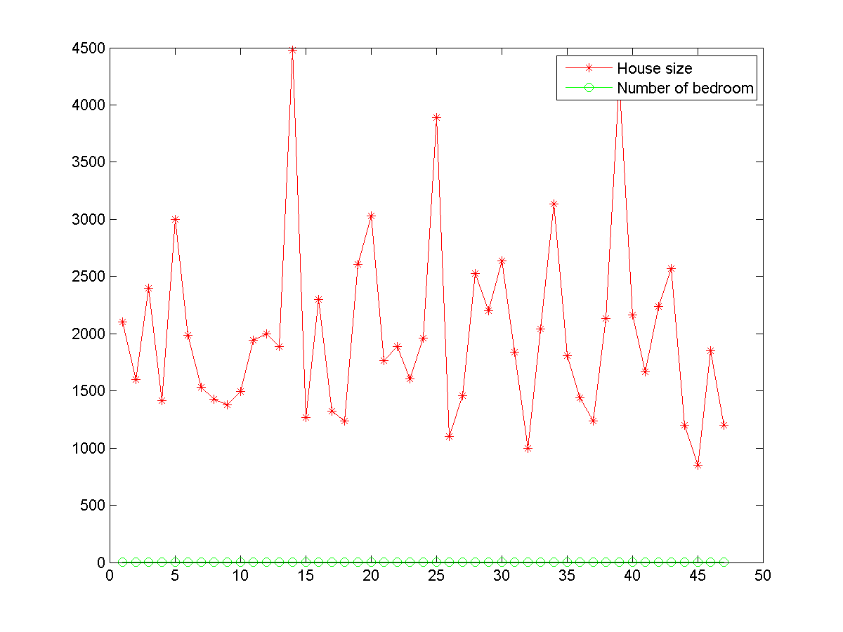
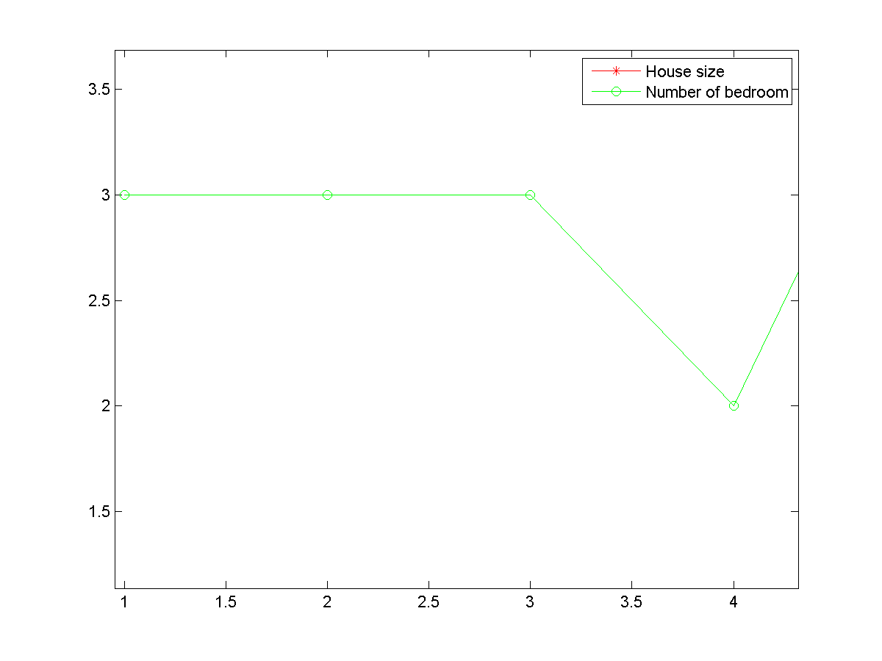
Feature Scaling
Get every feature into approximately a range.
P7

Slide 30
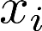
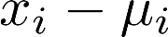
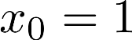
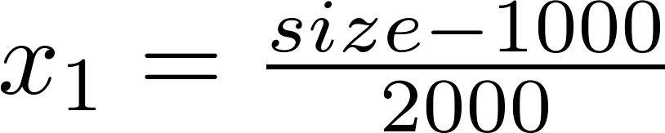
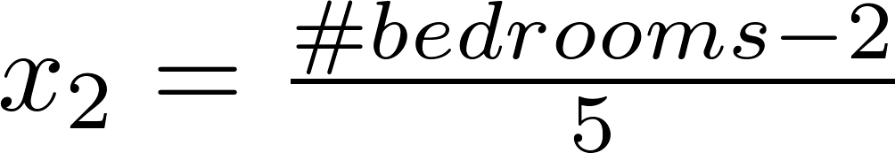
Mean normalization
Replace with to make features have approximately zero mean (Do not apply to ).
E.g.

Slide 31

P7
Let’s implement the feature normalization!

Slide 32
Gradient descent :
Repeat
(simultaneously update for
)
P8
Let’s implement the gradient descent for multi variables!

Slide 33


for i = 2 : numIter
thetaSeq(:, i) = thetaSeq(:, i-1) - ...
alpha / m * (X' * (X * thetaSeq(:, i-1) - y));
jSeq(i) = computeCostVect(X, y, thetaSeq(:, i));
end
P8

Slide 34

X * thetaSeq(:, i-1)
P8

Slide 35


X’
X * thetaSeq(:, i-1)
- y
P8

Slide 36



function J = computeCostVect(X, y, Theta)
% J = sum( (X * Theta - y).^2 )/ 2 * length(y);
J = (X * Theta - y)' * (X * Theta - y) / 2 * length(y);

Slide 37

The gradDesVect and computeCostVect can also work with the one variable case.
P8

Slide 38
Gradient descent in engineering

Slide 39
Gradient descent in practice II: Learning rate
Linear Regression with multiple variables
Machine Learning

Slide 40


Gradient descent
“Debugging”: How to make sure gradient descent is working correctly.
How to choose learning rate .

Slide 41


Making sure gradient descent is working correctly.
Example automatic convergence test:
Declare convergence if decreases by less than in one iteration.
No. of iterations

Slide 42

Making sure gradient descent is working correctly.
Gradient descent not working.
Use smaller .
No. of iterations
No. of iterations
No. of iterations
For sufficiently small , should decrease on every iteration.
But if is too small, gradient descent can be slow to converge.

Slide 43
Summary:
If is too small: slow convergence.
If is too large: may not decrease on every iteration; may not converge.
To choose , try

Slide 44
Features and polynomial regression
Linear Regression with multiple variables
Machine Learning

Slide 45

Housing prices prediction

Slide 46





Polynomial regression
Price
(y)
Size (x)

Slide 47
Choice of features
Price
(y)
Size (x)

Slide 48

h = theta0 + theta1*x + theta2*x.^2 + theta3*x.^3
load '../Data/dataChap3B.mat';
P9

Slide 49

h = theta0 + theta1*x + theta2*x.^2 + theta3*x.^3
load '../Data/dataChap3B.mat';
P9

Slide 50
Normal equation
Linear Regression with multiple variables
Machine Learning

Slide 51

Gradient Descent
Normal equation: Method to solve for
analytically.

Slide 52







Intuition: If 1D
(for every )
Solve for

Slide 53









Examples:
 | Size (feet²) | Number of bedrooms | Number of floors | Age of home (years) | Price ($1000)
1 | 2104 | 5 | 1 | 45 | 460
1 | 1416 | 3 | 2 | 40 | 232
1 | 1534 | 3 | 2 | 30 | 315
1 | 852 | 2 | 1 | 36 | 178
Size (feet²) | Number of bedrooms | Number of floors | Age of home (years) | Price ($1000)
2104 | 5 | 1 | 45 | 460
1416 | 3 | 2 | 40 | 232
1534 | 3 | 2 | 30 | 315
852 | 2 | 1 | 36 | 178
Notes:
Pop-up Quiz

Slide 54




Examples:
 | Size (feet²) | Number of bedrooms | Number of floors | Age of home (years) | Price ($1000)
1 | 2104 | 5 | 1 | 45 | 460
1 | 1416 | 3 | 2 | 40 | 232
1 | 1534 | 3 | 2 | 30 | 315
1 | 852 | 2 | 1 | 36 | 178
1
Size (feet²) | Number of bedrooms | Number of floors | Age of home (years) | Price ($1000)
2104 | 5 | 1 | 45 | 460
1416 | 3 | 2 | 40 | 232
1534 | 3 | 2 | 30 | 315
852 | 2 | 1 | 36 | 178
3000 | 4 | 1 | 38 | 540
Notes:
Pop-up Quiz

Slide 55




examples ; features.
E.g. If

Slide 56


is inverse of matrix .
Octave or Matlab:
pinv(X’*X)*X’*y
P10
Let’s implement the normal equation based regression!

Slide 57
training examples, features.
Gradient Descent
Normal Equation
Need to choose .
Needs many iterations.
No need to choose .
Don’t need to iterate.
Works well even when is large.
Need to compute
Slow if is very large.

Slide 58
Normal equation and non-invertibility (optional)
Linear Regression with multiple variables
Machine Learning

Slide 59
Normal equation
What if is non-invertible? (singular/ degenerate)
Octave:
pinv(X’*X)*X’*y

Slide 60



What if is non-invertible?
Redundant features (linearly dependent).
E.g. size in feet²
size in m²
Too many features (e.g. ).
Delete some features, or use regularization.

